Slide 1







Data Analyst Capstone
William Chaudoin
04/28/23

Slide 2


OUTLINE
Executive Summary
Introduction
Methodology
Results
Visualization – Charts
Dashboard
Discussion
Findings & Implications
Conclusion
Appendix

Slide 3


EXECUTIVE SUMMARY
Data Science and Information Technology are ever changing fields. With new applications and methods being developed constantly.
To enter these career fields, requires a specific skillset and expertise in a variety of languages, programs, and statistical methods.
To be become the best candidate, an individual needs to know not only what the most desired current skills are but what will be the most desired skills in the future.
This presentation will answer these questions by analyzing and visualizing current data associated with existing professionals within the field.

Slide 4
INTRODUCTION
This presentation is for individuals who wish to enter the Data Science or Information Technology fields along with existing professionals that are looking for ways to expand their skillset to become more marketable for other positions.
All recommendations are based on an analysis and visualization of obtained data.
This presentation seeks to not only answer what are the current in demand skills but what they will be in the future as well.

Slide 5
METHODOLOGY
This project was conducted using a survey dataset, which prior to cleaning contained 11552 observations. This dataset asked respondents a variety of questions from whether they used open-source software to their country of origin.
This dataset was cleaned in order to remove duplicates and to replace any missing values. In addition to compiling existing information into new variables for easier analysis.
The data underwent an exploratory analysis to determine correlations, descriptive statistics, distribution, and to identify outliers.
It was visualized in various ways from standalone plots to integrated enhanced dashboards using IBM Cognos Analytics.

Slide 6

RESULTS

Slide 7
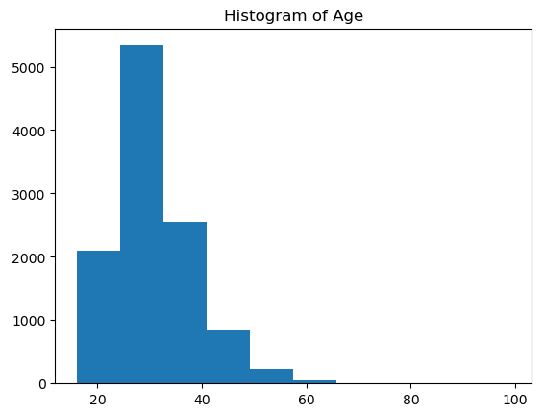
Distribution of Respondent Age

Slide 8
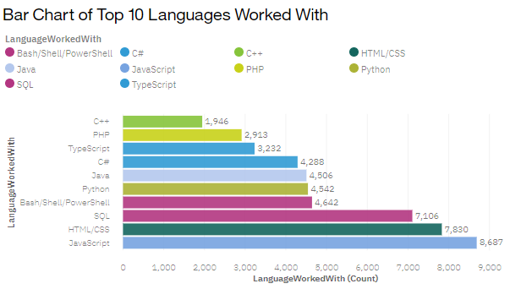
PROGRAMMING LANGUAGE TRENDS: Current

Slide 9
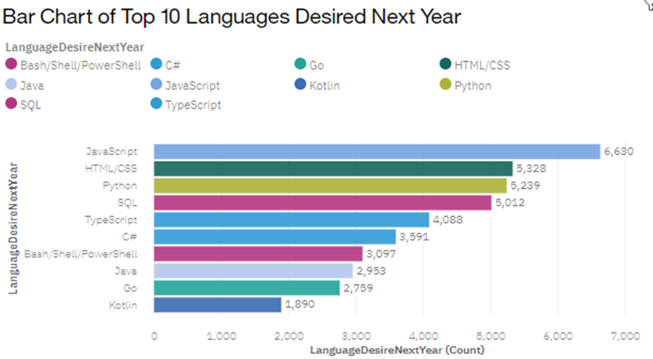
PROGRAMMING LANGUAGE TRENDS: Next Year

Slide 10
PROGRAMMING LANGUAGE TRENDS - FINDINGS & IMPLICATIONS
The data showed there is a strong overlap between what is desired now and what is desired next year.
Javascript is the number one language desired for both periods with HTML being the runner.
Meanwhile there has been change in interest in some languages such as Python, PowerShell, and SQL.
Interest in Python grew, while PowerShell and SQL saw a decrease in interest.
These trends imply that there is a demand for specific skills that do not fade with time.
However, some of these skills will see slight increases and decreases overtime.
The primary languages of interest seem to be JavaScript and HTML. Individuals with these skills are more likely to find employment, while Python looks to be more marketable in the future in comparison to SQL and PowerShell.

Slide 11
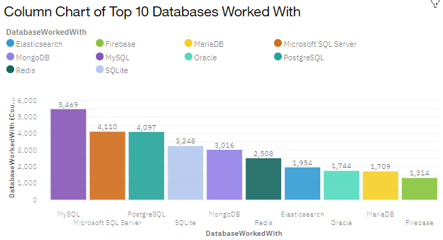
DATABASE TRENDS: Current

Slide 12
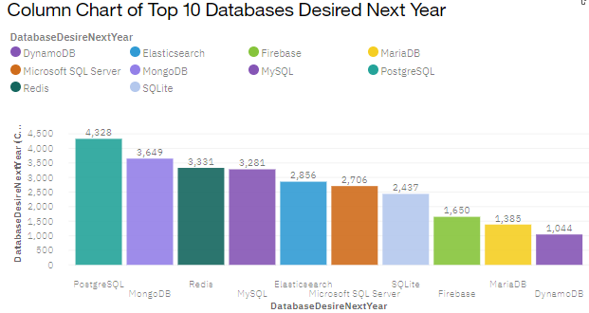
DATABASE TRENDS: Next Year

Slide 13
DATABASE TRENDS - FINDINGS & IMPLICATIONS
There are a lot of changes year to year when it comes to the preferred database.
Currently MySQL and Microsoft SQL Server reign supreme, but next year the interest in these will fall to PostGres SQL and MongoDB.
MongoDB appears to be growing in popularity as a more in-demand skill.
Meanwhile, SQLlite decreased significantly from being the 4th most desired to the 7th most desired.
Individuals should evaluate whether their current knowledge of the preferred database in accurate.
Moving forward, MongoDB appears to be playing a larger role in the Data Science and IT fields along with PostGres SQL.
MySQL still has a role in the market but Microsoft SQL Server and SQLlite are falling behind in desirability.

Slide 14

DASHBOARD
For further analysis consult the linked Cognos Analyics Dashboard: Located Here

Slide 15
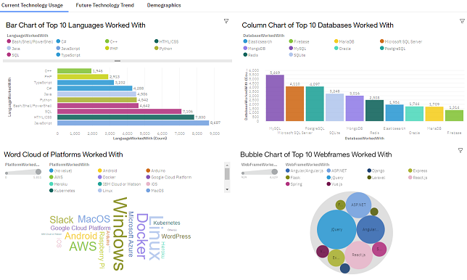
DASHBOARD TAB 1

Slide 16
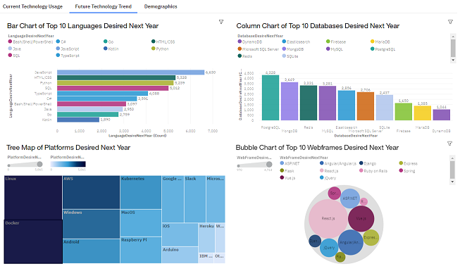
DASHBOARD TAB 2

Slide 17
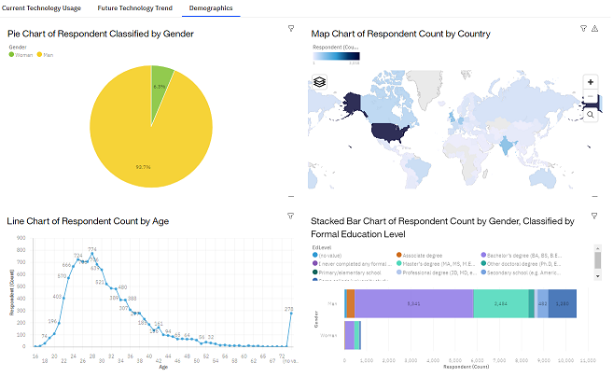
DASHBOARD TAB 3

Slide 18

DISCUSSION

Slide 19
OVERALL FINDINGS & IMPLICATIONS
The top programming languages are JavaScript and HTML with Python, SQL, PowerShell, and TypeScript being other popular ones now or in the future.
The desired databases are changing fairly quickly with MongoDB soon to become a top database while MySQL and Microsoft SQL Server are falling out of favor.
Regarding Platforms, Linux is still a popular platform along with Windows, while the latter is falling out of favor for others such as Docker.
jQuery is the current top Webframe but soon to be overtaken by React.js
A strong foundation in JavaScript, HTML, Python, and SQL will aid an individual currently but also prepare them moving forward. Learning TypeScript will prepare an individual for the future.
Understanding PostGres SQL, MongoDB, and MySQL are needed skills for tomorrow.
Knowledge on how to utilize Linux, Docker, and Windows are requirements for today and tomorrow.
jQuery is currently very popular, but React.js is growing.

Slide 20

CONCLUSION
Data Science and Information Technology are two very interesting but changing fields. The best outlook when entering these fields is to always be aware of changes and to find ways to always increase an individual’s knowledge and skill level.
Focus on gaining a strong foundation in current popular languages, databases, platforms, and webframes.
Afterwards, continue to grow a skillset by tackling next year’s most desired languages, databases, platforms, and webframes.

Slide 21

APPENDIX

Slide 22
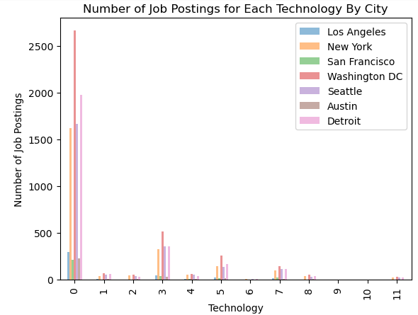
JOB POSTINGS

Slide 23
POPULAR LANGUAGES

Slide 24
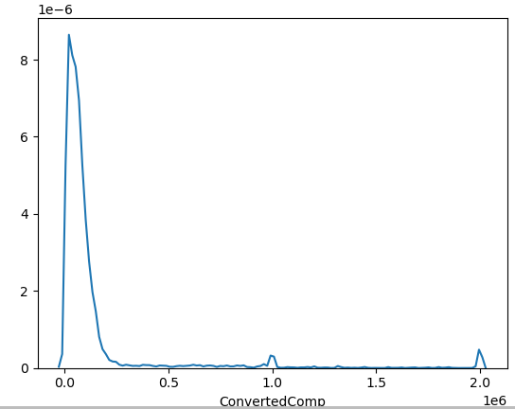
Line Graph of Converted Comp

Slide 25
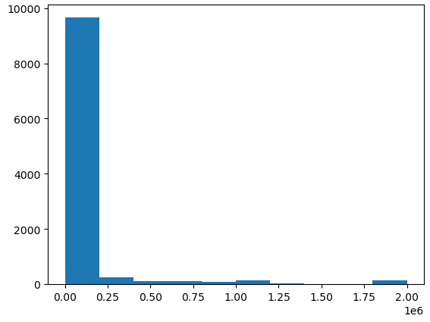

Histogram of Converted Comp

Slide 26
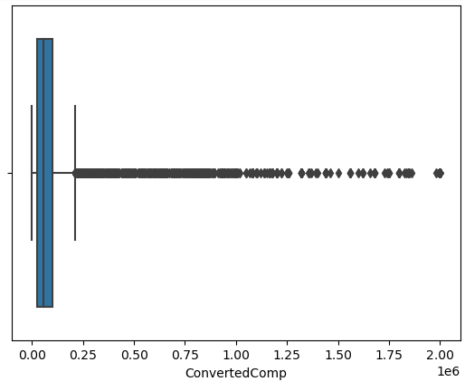
Boxplot of Converted Comp to check for Outliers

Slide 27
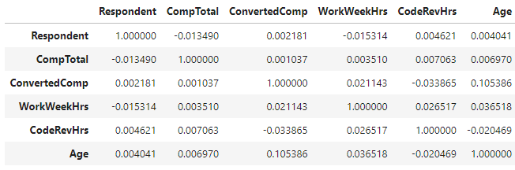
Correlation Matrix for Age and other variables

Slide 28
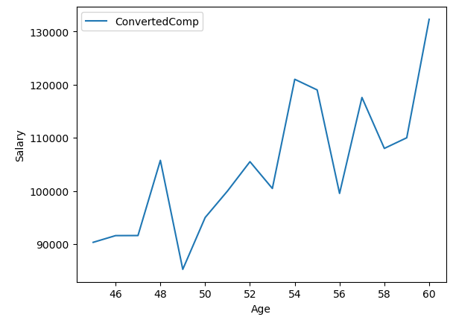
Relationship of Converted Comp and Age

